Slide 1
CS4042 – Information Processing Techniques(IPT)
Week – 01
Sep 6-10, 2021
Instructor: Basit Ali

Slide 2
Pre-Requisite
You should have sound knowledge of programming
You should have sound knowledge of data structures
You should have sound knowledge of database server and writing queries

Slide 3
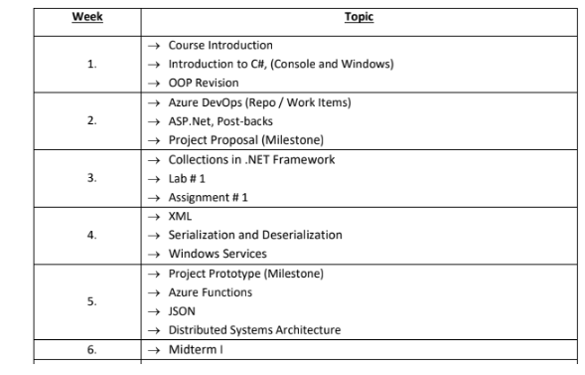
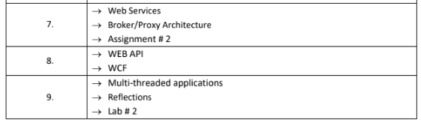
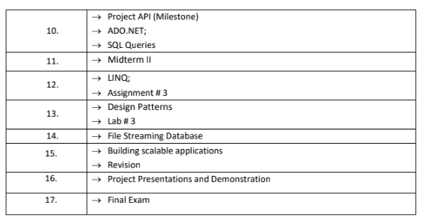
Course Outline

Slide 4
Grading Scheme
Assignments 10%
Labs 3%
Project 12%
Midterms 25%
Final 50%

Slide 5
Books
Pro C# 7 With .Net and .Net Core
By “Andrew Troelsen and Philip Japikse” (Apress Publications)

Slide 6
Tools Required
Visual Studio (VS 2017/2019/Code)
Windows Application
Windows Service
Web Application (ASP.Net)
Web Service (ASMX)
WCF
WEB API
SQL Server ( SQL Server 2014 + Professional or Enterprise Edition)

Slide 7
What is Information Processing Technique?
Using technology efficient based on the scenario under consideration.
Example:
Choosing Sorting Algorithm
Choosing Data Base , choosing types of join
Choosing different Web Service v/s WCF v/s Web API

Slide 8
The .NET Framework
VB
C++
C#
JScript
…
Visual Studio.NET
Common Language Specification
ASP.NET: Web Services
And Web Forms
Windows forms
ADO.NET: Data and XML
Base Class Library
Common Language Runtime

Slide 9
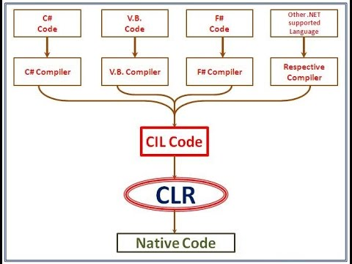
Common Language Runtime (CLR)
Common Classes for all Languages
Common Types for all Languages
Runtime Controls Compilation to Machine Code

Slide 10
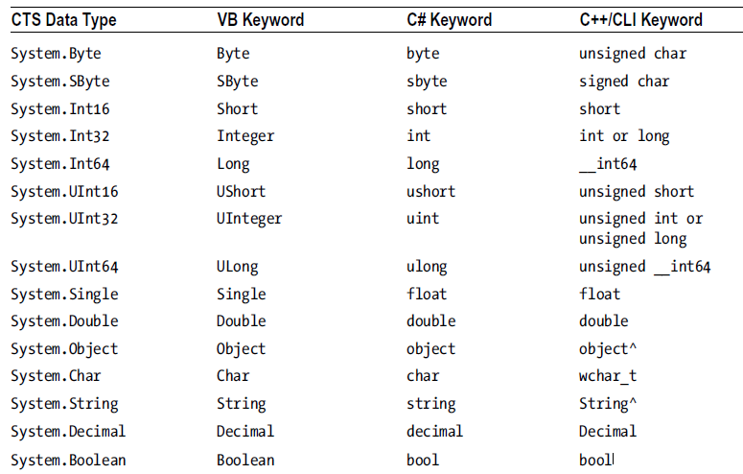
Common type system (CTS)

Slide 11
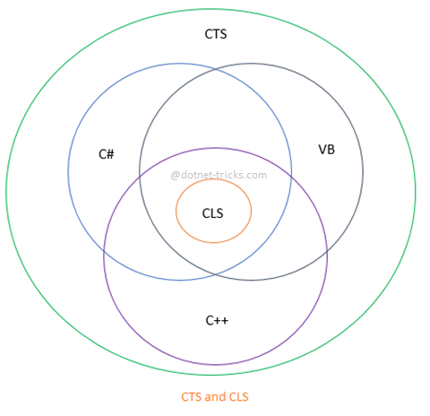
Common Language Specification (CLS)
A subset of common types and programming constructs that all .NET programming languages can agree on.

Slide 12
Base Class library
Available for all .Net languages.
Encapsulate various primitives such as threads, file input/output (I/O), graphical rendering systems, and interaction with various external hardware devices
It also provides support for a number of services required by most real-world applications.

Slide 13
The CLR, CTS, CLS, and base class library relationship

Slide 14
Managed vs. Unmanaged Code
It is important to note that the C# language can be used only to build software that is hosted under the .NET runtime.
The term used to describe the code targeting the .NET runtime is managed code. The binary unit that contains the managed code is termed an assembly.
Conversely, code that cannot be directly hosted by the .NET runtime is termed unmanaged code.

Slide 15
Compilation in .NET
MSIL (Microsoft Intermediate Language)
JIT (Just In Time)
Metadata
Manifest

Slide 16
Execution Model
Source code
VB
C#
C++
Unmanaged
Component
Compiler
Compiler
Compiler
Managed
code
Assembly
IL Code
Assembly
IL Code
Assembly
IL Code
Common Language Runtime
JIT Compiler
Native Code
Operating System Services

Slide 17

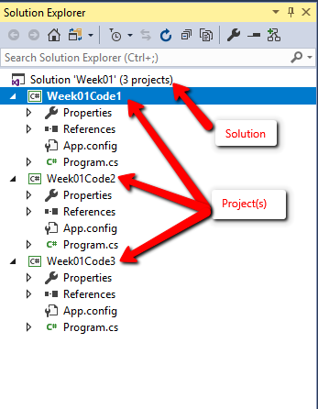


Solution v/s Project

Slide 18
Recap of OOP
Pillars of Object-Oriented Programming:
Inheritance
Encapsulation
Polymorphism
Abstraction
Notes:
Encapsulation v/s abstraction
Encapsulate hides variables or some implementation that may be changed so often in a class to prevent outsiders access it directly. They must access it via getter and setter methods.
Abstraction is used to hiding something too but in a higher degree(class, interface). Clients use an abstract class(or interface) do not care about who or which it was, they just need to know what it can do.

Slide 19
Understanding the Common Type System
A given assembly may contain any number of distinct types.
In the world of .NET, type is simply a general term used to refer to a member from the set
{class, interface, structure, enumeration, delegate}.

Slide 20
CTS Class Types
Every .NET-aware language supports, at the least, the notion of a class type, which is the cornerstone of object-oriented programming (OOP). A class may be composed of any number of members (such as constructors, properties, methods, and events) and data points (fields).
In C#, classes are declared using the class keyword, like so:
class Calc { public int Add(int x, int y) { return x + y; } }

Slide 21
CTS Interface Types
Interfaces are nothing more than a named collection of abstract member definitions, which may be supported (i.e., implemented) by a given class or structure.
In C#, interface types are defined using the interface keyword.
By convention, all .NET interfaces begin with a capital letter I, as in the following example:
public interface Idraw { void Draw(); }

Slide 22
CTS Structure Types
A structure can be thought of as a lightweight class type having value-based semantics. Typically, structures are best suited for modeling geometric and mathematical data and are created in C# using the struct keyword, as follows:
struct Point { // Structures can contain fields. public int xPos, yPos; // Structures can contain parameterized constructors. public Point(int x, int y) { xPos = x; yPos = y;} // Structures may define methods. public void PrintPosition() { Console.WriteLine("({0}, {1})", xPos, yPos); } }
No inheritance

Slide 23
CTS Enumeration Types
Enumerations are a handy programming construct that allow you to group name-value pairs.
// A C# enumeration type. enum CharacterType { Wizard = 100, Fighter = 200, Thief = 300 }
By default, the storage used to hold each item is a 32-bit integer; however, it is possible to alter this storage slot if need be (e.g., when programming for a low-memory device such as a mobile device). Also, the CTS demands that enumerated types derive from a common base class, System.Enum.
enum characterType : Byte
{
Wizard = 1;
Fighter = 2;
Thief = 3;
}

Slide 24
CTS Delegate Types
Delegates are the .NET equivalent of a type-safe, C-style function pointer.
The key difference is that a .NET delegate is a class that derives from System.MulticastDelegate, rather than a simple pointer to a raw memory address.
delegate int BinaryOp(int x, int y);
Delegates are critical when you want to provide a way for one object to forward a call to another object and provide the foundation for the .NET event architecture.

Slide 25
Access Specifiers
Public
Private
Protected
Internal
Protected Internal
Private Protected
Notes:
Internal : public within same assembly
protected internal The type or member can be accessed by any code in the assembly in which it is declared, or from within a derived class in another assembly.
private protected The type or member can be accessed only within its declaring assembly, by code in the same class or in a type that is derived from that class.
public class BaseClass { private protected int myValue = 0; }
public class DerivedClass1 : BaseClass {
void Access() {
BaseClass baseObject = new BaseClass();
// Error CS1540
baseObject.myValue = 5;
// OK, myValue = 5; } }
class DerivedClass2 : BaseClass {
void Access() {
// Error // myValue = 10; } }

Slide 26
Default access
enum: The default and only access modifier supported is public.
class: The default access for a class is private. It may be explicitly defined using any of the access modifiers.
interface: The default and only access modifier supported is public.
struct: The default access is private with public and internal supported as well.

Slide 27
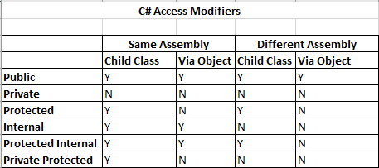
Notes:
AccessModifersTestSolution

